Slide 1
FIT-4 Initiative : GtP for CLP
GtP: Cost Saving Commentary
1. Focados CLP project scope involves subsea cleaning & installing anodes -4 nos. Retrosled & 6 nos. Retropods etc.
2. Installation is expected to be in Q3 2023, diving operation is expected to be completed on time within Q2, while other installation
works would be completed Q3.
3. There is potential to save or avoid $100k from the installation cost from early completion one month ahead of schedule.
Summary Statement
The Forcados CLP project was successfully completed one month ahead of schedule. 4 nos. Retrosled & 6 nos. Retropods were to be installed.
However, during installation works 5 out 6 retropods were installed, due to concurrent operations within that work environment, and operational reasons, it was decided to descope the installation of the last retropods.
The last retropod is to be installed by another contractor working in that vicinity already engaged by SPDC.
The main contractor for the base scope issued a credit note to PMT of circa F$154k to close out the P.O. This will result in a cost avoidance of F$154k on the main scope for not installing the 6th retroslad.

Slide 2
FIT-4 Initiative : GtP for CLP
Cost Saving Premise.
1. P.O Value (P.O.V)of 263,025,000.00 naira & $3,340,000.0 approved
2. Value of Work done(VOWD) of 253,293,075.00 naira & $3,216,075.00.
3. Variance or Savings/ Avoidance.
Cost savings = P.O.V –VOWD
9,731,925.00 naira & $123,580.00
= F$154,000.00 (CAPEX)
= F$46,200.00 (FCF)

Slide 3
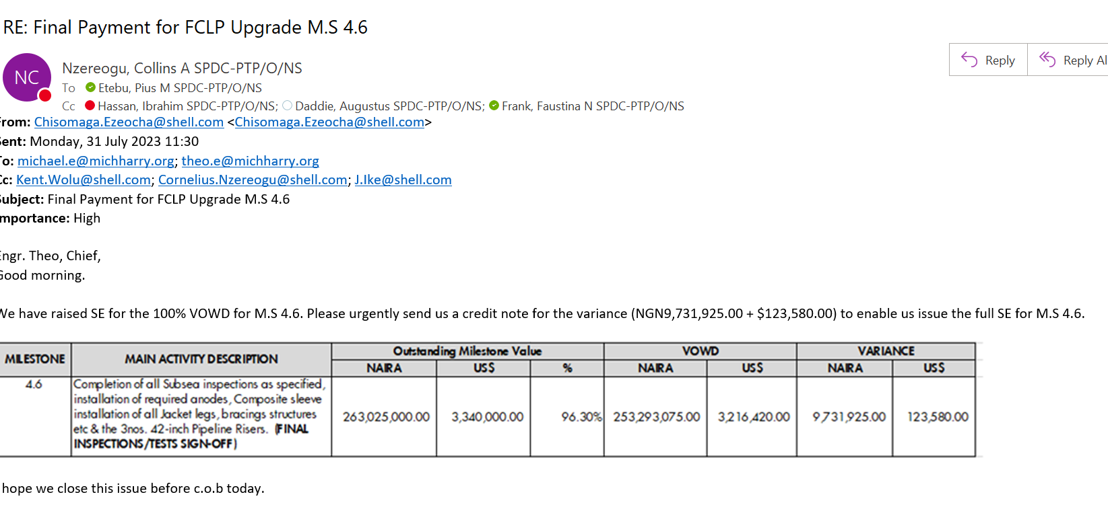
FIT-4 Initiative : GtP for CLP

